Slide 1
CS 3186 Equivalence of NFA & DFA Section 2.3

Slide 2
Equivalence of Machines
Definition for Automata (DFA or NFA):
Machine M₁ is equivalent to machine M₂
if L(M₁) = L(M₂)

Slide 3
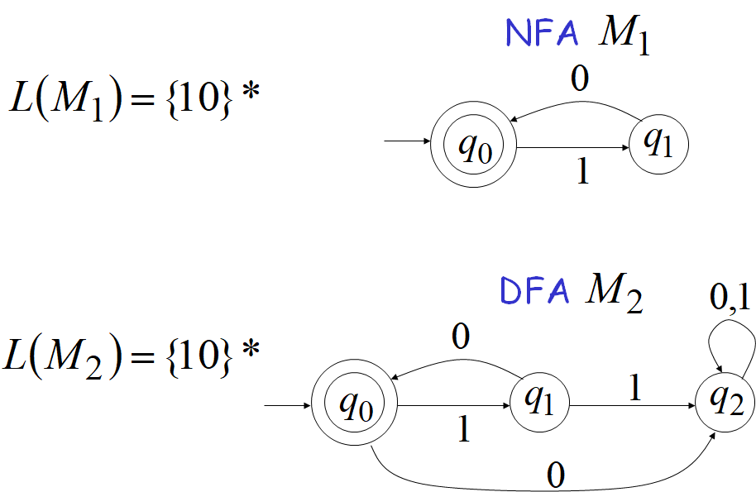
Example of equivalent machines

Slide 4
Equivalence of NFA and DFA
We will prove:
{Language accepted by NFAs}
= {Regular Languages}
= {Language accepted by DFAs}
i.e., NFAs and DFAs have the
same computation power

Slide 5
NFA to DFA: Remarks
We are given an NFA, M
We want to convert it
to an equivalent DFA M’
With L(M) = L(M’)

Slide 6
NFA to DFA : Step 1
{Languages ⊇ {Regular
accepted by NFAs} Languages}
Proof: Every DFA is trivially an NFA
⇒ Any language L accepted by a DFA is also accepted by an NFA

Slide 7
NFA to DFA : Step 2
{Languages ⊆ {Regular
accepted by NFAs} Languages}
Proof: Any NFA can be converted to an equivalent DFA
⇒ Any language L accepted by an NFA is also accepted by a DFA

Slide 8
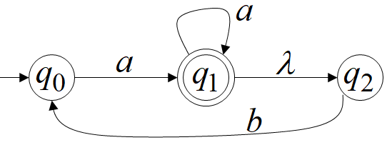
Proof by construction: Convert NFA to DFA
NFA M (given)
Construct a DFA M’ such that the language accepted by this DFA is the same language as accepted by the given NFA M . i.e., L(M) = L(M’)

Slide 9
Procedure to convert NFA to DFA – Step 1
Step 1.
Initial state of NFA: q₀
⇓
Initial state of DFA {q₀}
(A state in the constructed DFA is a subset of the states Q in the given NFA)

Slide 10
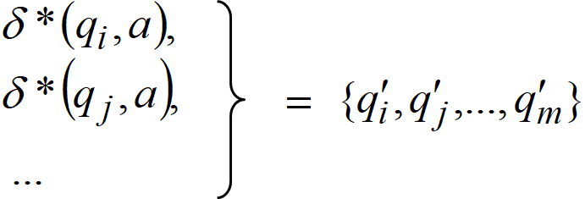
Procedure to convert NFA to DFA – Step 2
Step 2. For every DFA’s state
{q_{i},q_{j},…q_{m}}, Compute in the NFA
Add transition to DFA
δ({q_{i},q_{j},…q_{m}},a) = {q’_{i},q’_{j},…q’_{m}}

Slide 11
NFA to DFA – Step 2 (repetition)
Repeat Step 2 for all symbols in alphabet,
until
no more transitions can be added.

Slide 12
Procedure to convert NFA to DFA – Step 3
Step 3.
For any DFA state {q_{i},q_{j},…q_{m}},
If some q_{j} is a final state in the NFA
Then {q_{i},q_{j},…q_{m}}, is a final state in the DFA
If λ is in the language accepted by NFA, then {q₀}, the initial state, also becomes a final state in the DFA

Slide 13
Procedure to convert NFA to DFA
If the NFA has states q₀,q₁,q₂
the DFA has states in the power set
∅, {q₀},{q₁},…{q₁,q₂}…. {q₃,q₄,q₇}…

Slide 14
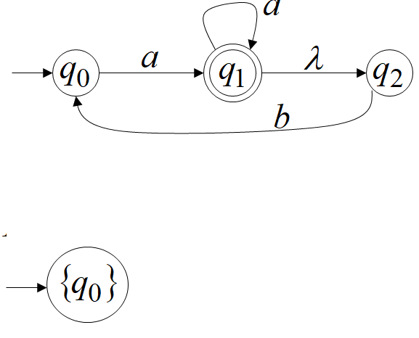
NFA to DFA: Example#1 (Step 1)
NFA M
DFA M’

Slide 15
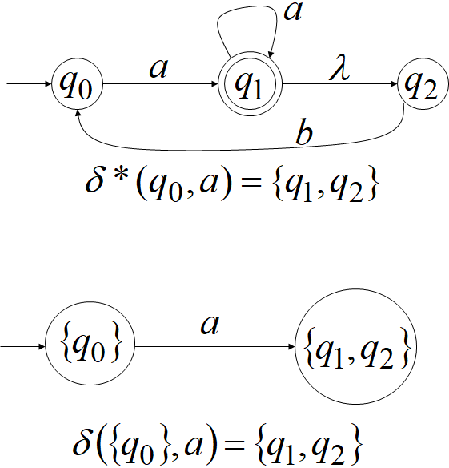
NFA to DFA: Example#1 (Step 2)
NFA M
DFA M’

Slide 16
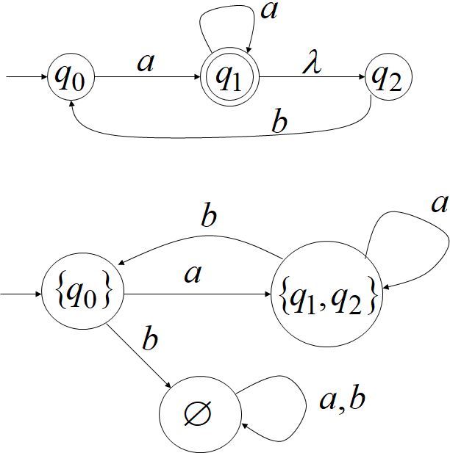
NFA to DFA: Example#1 (Step 2 repeat)
NFA M
DFA M’

Slide 17
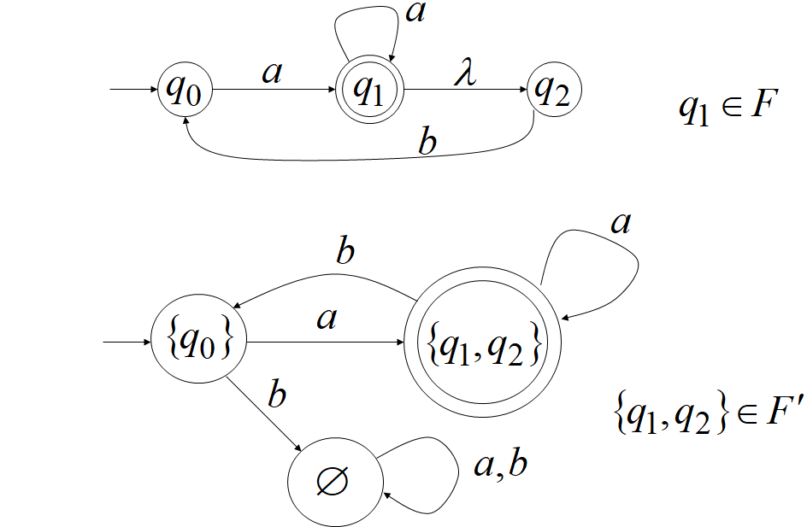
NFA to DFA: Example#1 (Step 3)
NFA M
DFA M’

Slide 18
NFA to DFA
By the process of construction,
If there exists a walk on a string, w, from q₀ to q_{j} in the NFA M,
then there exists a walk from {q₀} to
{….. q_{j},…..} on the string w in the DFA M’
If q_{j} is a final state in M, then {….. q_{j},…..}
is a final state in M’.
Thus any string w accepted by M is also accepted by M’

Slide 19
NFA to DFA: Theorem
Take any NFA M
Apply procedure to obtain DFA M’
Then M and M’ are equivalent
L(M)=L(M’)
If w∈ L(M) then w∈ L(M’) and vice versa

Slide 20
Another Example #2
Given NFA M
Construct DFA M’

Slide 21
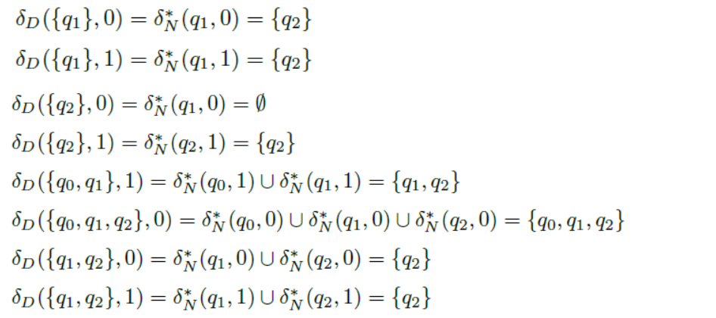
Another Example #2 (Continued)
Construct DFA M’

Slide 22
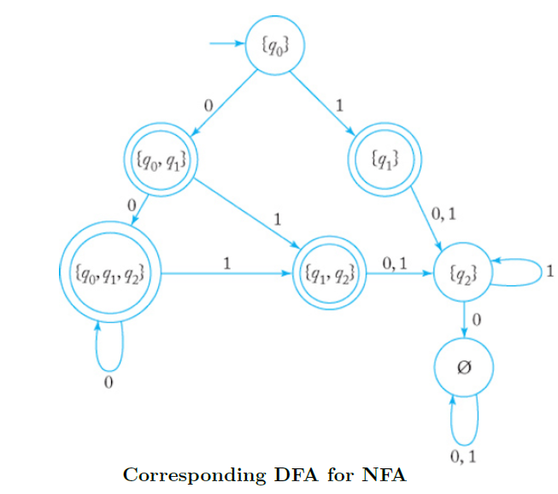

Slide 23
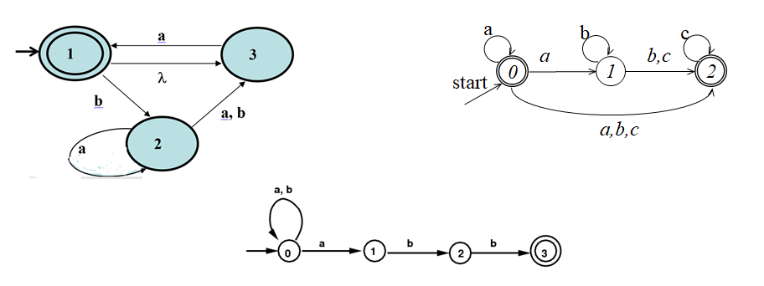
Homework 2.3
I) Do exercises : #1, #2, #3, #4 II) Convert the following NFAs to DFAs

Slide 24
CS3186 Reduction in number of states of a DFA Section 2.4

Slide 25
Equivalent or Indistinguishable States
Definition: Two states p and q are equivalent (or indistinguishable), if, for every string w ∈ Σ *, transition δ*( p , w ) ends in an accepting state if and only if δ*( q , w) does. There are efficient algorithms available for computing the sets of equivalent states of a given DFA.
Property: If p and q are indistinguishable and if q and r are indistinguishable, then p and r are also indistinguishable. i.e., all three states p, q, r are indistinguishable.

Slide 26
Minimization Technique for DFA
The number of states of an automaton has direct affect to the size of the machine realizing the automaton. Hence, it is very important to reduce the number of states, if possible.
The procedure to reduce the states of a DFA is based on finding and combining equivalent states.
This procedure uses the set partitioning technique. The technique is similar to one that they use for partitioning people into groups (each having certain preferences) based on their responses to questionnaire.

Slide 27
DFA-> Minimum DFA
Minimization Algorithm:
Step 0: Remove from M₁ the dead states and the states not reachable from the start state, if there are any. Any transitions to a dead state become undefined. A state is a dead state if it is not an accepting state and has no out-going transitions except to itself.
Step 1: We will divide Q (set of states) into two sets. One set will contain all final states and other set will contain non-final states. This partition is called P₀.
Step 2: Initialize k = 1

Slide 28
DFA-> Minimum DFA (Continued)
Step 3: Find P_{k} by partitioning the different sets of P_{k-1}. In each set of P_{k-1}, we will take all possible pair of states. If two states of a set are distinguishable, we will split the sets into different sets in P_{k}.
Note: Two states ( qi, qj ) are distinguishable in partition P_{k} if for any input symbol a, δ ( qi, a ) and δ ( qj, a ) are in different sets in partition P_{k-1}.
Step 4: Repeat above step. Stop when P_{k} = P_{k-1} (No change in partition)
Step 5: All states of one set are merged into one state. Number of states in minimized DFA will be equal to number of sets in P_{k}.
Note: The initial state will be the set that contains the given initial state. Similarly the sets that contain any of the initial final states will be the final state of the minimal DFA

Slide 29
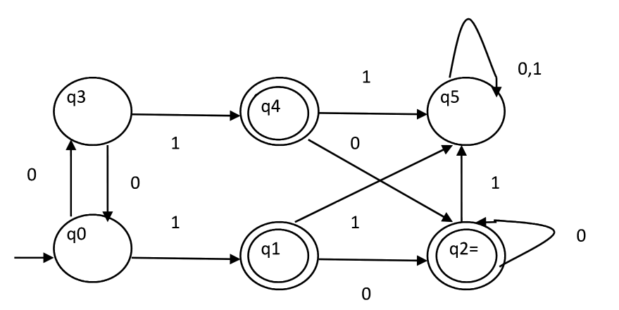
Minimal DFA : Example #1

Slide 30
Minimal DFA : Example #1
Step 1. P₀ will have two sets of states. One set will contain q1, q2, q4 which are final states of DFA and another set will contain remaining states.
So P₀ = { { q1, q2, q4 }, { q0, q3, q5 } }.
Step 2. Set k=1
Step 3: To calculate P₁, we will check whether sets of partition P₀ can be partitioned or not:

Slide 31
Minimal DFA : Example #1 (Step 3)
i) For set { q1, q2, q4 } :
δ ( q1, 0 ) = δ ( q2, 0 ) = q2 and
δ ( q1, 1 ) = δ ( q2, 1 ) = q5,
So q1 and q2 are not distinguishable.(can remain in the same partition)
Similarly, δ ( q1, 0 ) = δ ( q4, 0 ) = q2 and
δ ( q1, 1 ) = δ ( q4, 1 ) = q5, So q1 and q4 are not distinguishable.
Since, q1 and q2 are not distinguishable and q1 and q4 are also not distinguishable, So q2 and q4 are not distinguishable. So, { q1, q2, q4 } set will remain in the same partition in P1.

Slide 32
Minimal DFA : Example #1 (Step 3 continued.)
ii) For set { q0, q3, q5 } :
δ ( q0, 0 ) = q3 and δ ( q3, 0 ) = q0 δ ( q0, 1) = q1 and δ( q3, 1 ) = q4 Moves of q0 and q3 on input symbol 0 are q3 and q0 respectively which are in same set in partition P₀ .
Similarly, Moves of q0 and q3 on input symbol 1 are q3 and q0 which are in same set in partition P₀ . So, q0 and q3 are not distinguishable.
δ ( q0, 0 ) = q3 and δ ( q5, 0 ) = q5 and
δ ( q0, 1 ) = q1 and δ ( q5, 1 ) = q5 Moves of q0 and q5 on input symbol 1 are q3 and q5 respectively which are in different set in partition P₀. So, q0 and q5 are distinguishable. So, set { q0, q3, q5 } will be further partitioned into { q0, q3 } and { q5 }.

Slide 33
Minimal DFA : Example #1 (Step 3 continued..)
We have now determined the partition P₁:
P₁ = { { q1, q2, q4 }, { q0, q3}, { q5 } }
To calculate the next partition P₂, we will check similarly whether sets of partition P₁ can be partitioned or not.

Slide 34
Minimal DFA : Example #1 (Step 3 continued...)
iii)For set { q1, q2, q4 } :
δ ( q1, 0 ) = δ ( q2, 0 ) = q2 and δ ( q1, 1 ) = δ ( q2, 1 ) = q5, So q1 and q2 are not distinguishable. Similarly, δ ( q1, 0 ) = δ ( q4, 0 ) = q2 and δ ( q1, 1 ) = δ ( q4, 1 ) = q5, So q1 and q4 are not distinguishable. Since, q1 and q2 are not distinguishable and q1 and q4 are also not distinguishable, So q2 and q4 are not distinguishable.
So, { q1, q2, q4 } set will not be partitioned in P₂.

Slide 35
Minimal DFA : Example #1 (Step 3 continued....)
iv)For set { q0, q3 } :
δ ( q0, 0 ) = q3 and δ ( q3, 0 ) = q0 δ ( q0, 1 ) = q1 and δ ( q3, 1 ) = q4 Moves of q0 and q3 on input symbol 0 are q3 and q0 respectively which are in same set in partition P1. Similarly, Moves of q0 and q3 on input symbol 1 are q3 and q0 which are in same set in partition P1.
So, q0 and q3 are not distinguishable.

Slide 36
Minimal DFA : Example #1 (final steps)
v) For set { q5 }: Since we have only one state in this set, it can’t be further partitioned.
Step 4:
So, the next partition is P₂ = { { q1, q2, q4 }, { q0, q3 }, { q5 } }
Since, P₁=P₂, this is the final partition.
Partition P₂ means that q1, q2 and q4 states are equivalent and can be merged into one. Similarly, q0 and q3 are merged into one.
The initial state is the merged state { q0, q3 }
The final state is the merged state{ q1, q2, q4 }

Slide 37
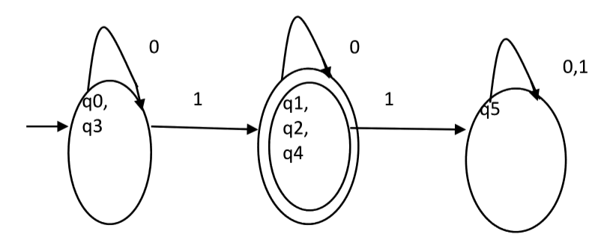
Minimal DFA: Example #1 (solved)
Minimized DFA for this example is given below

Slide 38
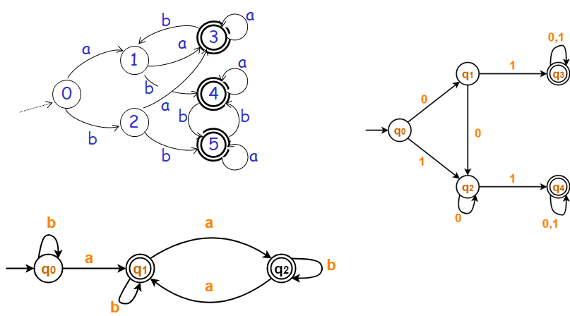
Homework 2.4
I) Do exercises : #1, #2 II) Convert the following DFAs to minimal DFAs

Slide 39
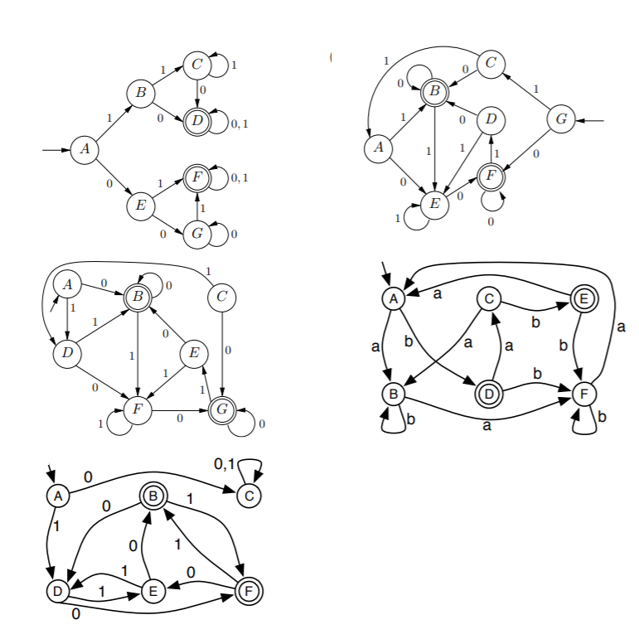
Homework 2.4 (more problems)
III) Convert the following DFAs to minimal DFAs

